Slide 1

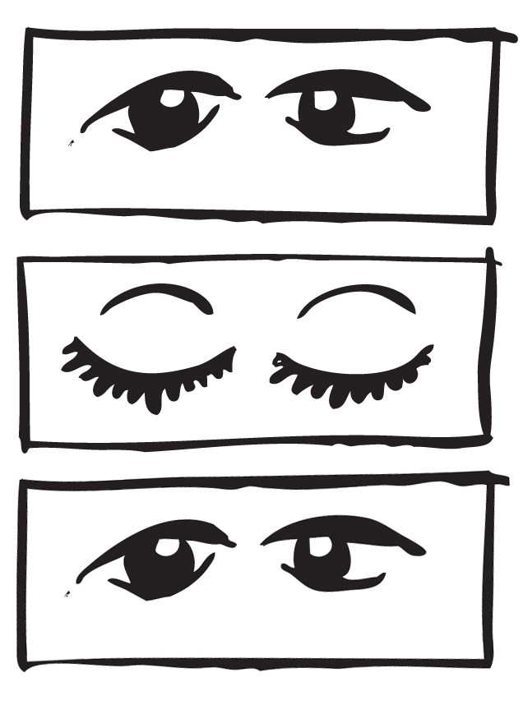







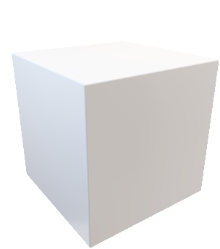
凝视射线

Slide 2
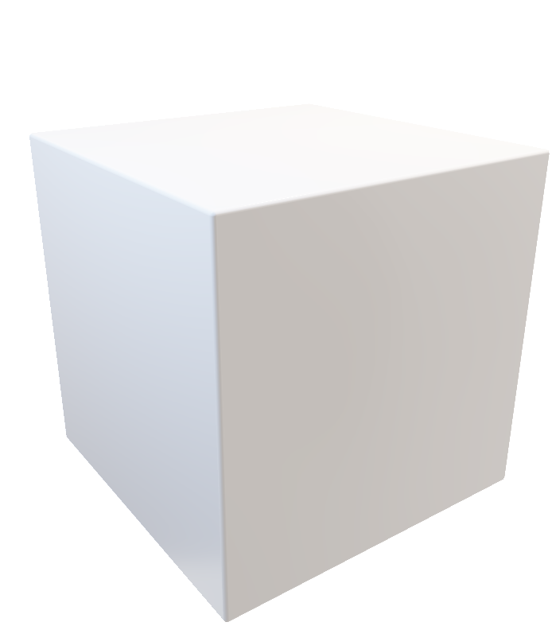


y
y
x
x
head forward
gaze forward
gaze forward
1
2
3
double blinking
progress bar getting full

